Slide 1
RISK
Credit Risk Management
GRUPO 3

Slide 2


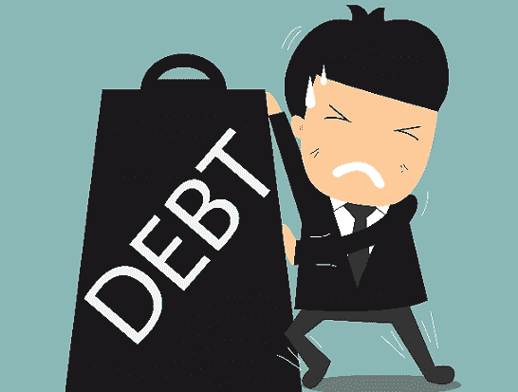
PERFILES DE CLIENTES DE CRÉDITOS
Demográficas
Empleo
Nivel de Ingresos
Vivienda
Conductuales
Record de pagos y atrasos
Cobranzas y fees
Meses desde el ultimo atraso
Estado del prestamo

Slide 3
¿QUÉ DEFINE A UN MAL PAGADOR?
RECORD DE PAGO
ESTADO PRESTAMO
VARIABLES A CONSIDERAR
MESES
RATIO

Slide 4
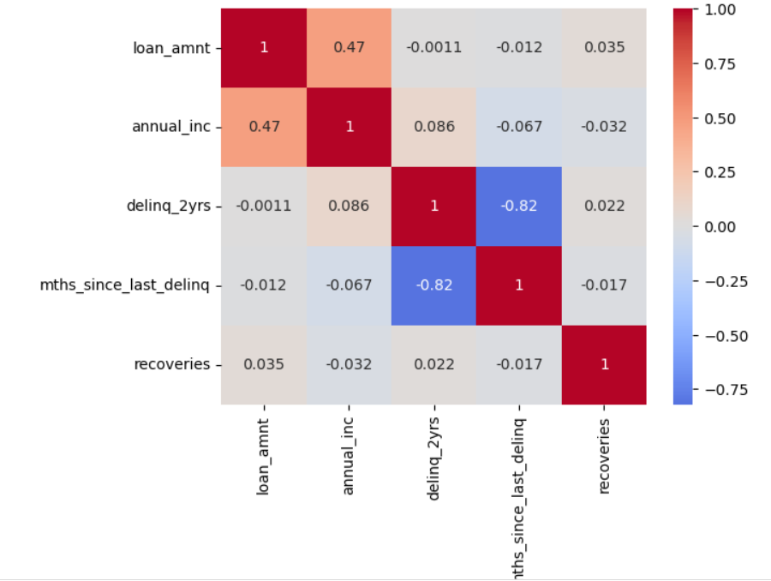
¿ESTAS VARIABLES ESTÁN RELACIONADAS?

Slide 5



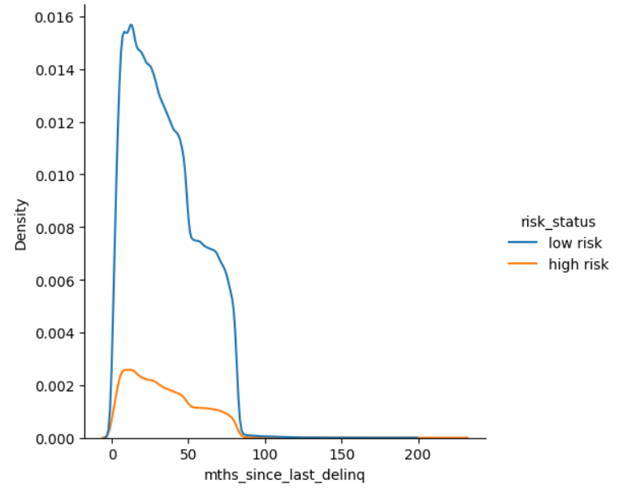
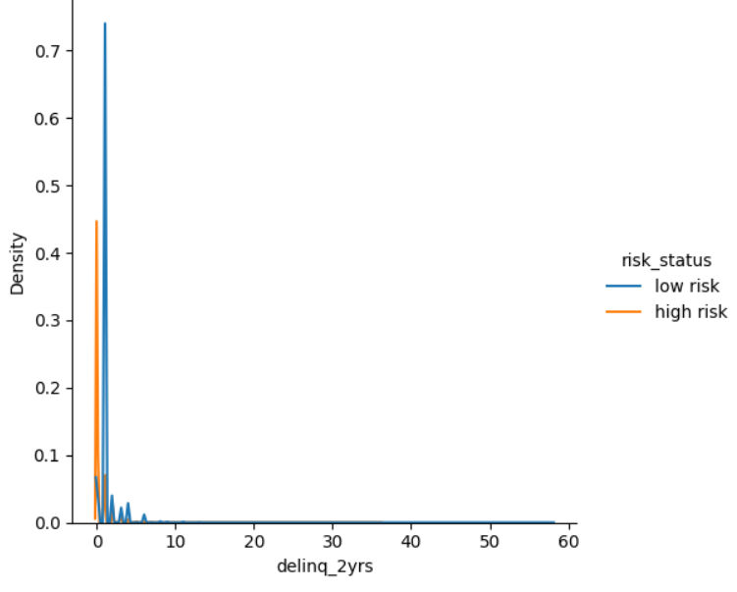
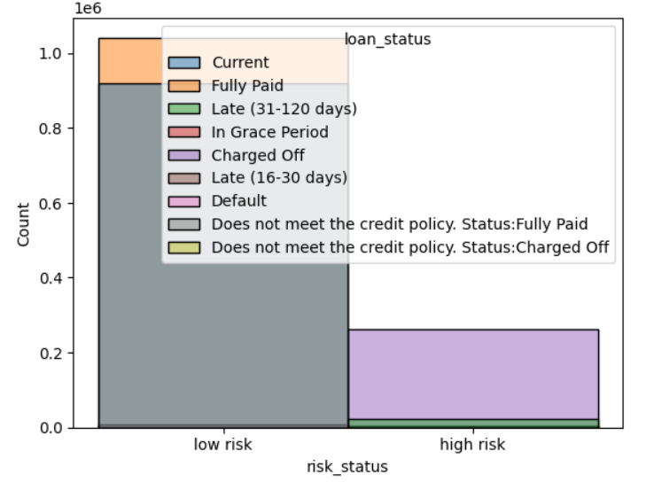
CONDUCTA DE UN MAL PAGADOR
Estados del préstamo.
Totalmente pagado
Activo – Periodo de Gracia
Incobrable
Retraso en el pago
Record atrasos (2 años)
Meses desde último atraso

Slide 6
Risk Management Infographics
Venus has a beautiful name and is the second planet from the Sun
Despite being red, Mars is a very cold place full of iron oxide dust
IDENTIFY RISK
ASSESS RISK
REVIEW CONTROLS
CONTROL RISK
Mercury is the closest planet to the Sun and the smallest one
Jupiter is a gas giant and the biggest one in the Solar System

Slide 7
Risk Management Infographics
IDENTIFY RISK
ASSESS RISK
REVIEW CONTROL
CONTROL RISK
It's the closest planet to the Sun
Despite being red, Mars is a cold place
It's a gas giant and the biggest planet
Venus is the second planet to the Sun

Slide 8
Risk Management Infographics
IDENTIFY RISK
ASSESS RISK
Venus has a beautiful name and is the second planet from the Sun
Despite being red, Mars is a very cold place full of iron oxide dust
REVIEW CONTROLS
CONTROL RISK
Mercury is the closest planet to the Sun and the smallest one
Jupiter is a gas giant and the biggest one in the Solar System

Slide 9
Risk Management Infographics
IDENTIFY RISK
Venus has a beautiful name and is the second one from the Sun
ASSES RISK
Mercury is the closest planet to the Sun and the smallest one
REVIEW CONTROL
Despite being red, Mars is a cold place full of iron oxide dust
CONTROL RISK
Jupiter is a gas giant and the biggest planet in the Solar System

Slide 10
Risk Management Infographics
RISK ASSESSMENT MATRIX
CERTAIN
LOW
MODERATE
HIGH
EXTREME
EXTREME
LIKELY
LOW
MODERATE
HIGH
HIGH
EXTREME
LIKELIHOOD
POSSIBLE
LOW
MODERATE
MODERATE
HIGH
HIGH
UNLIKELY
LOW
LOW
MODERATE
MODERATE
MODERATE
RARE
LOW
LOW
LOW
LOW
LOW
INSIGNIFICANT
MINOR
SIGNIFICANT
MAJOR
CATASTROPHIC
SIGNIFICANCE

Slide 11
Risk Management Infographics
1º risk
Mercury is the closest planet to the Sun
2º risk
Saturn is the only planet in the Solar System with rings
3º risk
Despite being red, Mars is a cold place
4º risk
Venus has a beautiful name, but it’s hot

Slide 12
Risk Management Infographics
MEDIUM RISK
Despite being red, Mars is a very cold place full of iron oxide dust
LOW RISK
HIGH RISK
Mercury is the closest planet to the Sun and also the smallest one
RISK
Jupiter is a gas giant and the biggest planet in the Solar System

Slide 13
Risk Management Infographics
IDENTIFY RISK
ASSESS RISK
Venus has a beautiful name and is the second planet from the Sun
A
Despite being red, Mars is a very cold place full of iron oxide dust
B
C
REVIEW CONTROLS
CONTROL RISK
Mercury is the closest planet to the Sun and the smallest one
D
Jupiter is a gas giant and the biggest planet in the Solar System

Slide 14
Risk Management Infographics
Identify risk
Saturn is the only planet with rings of them all
AsseSs risk
Despite being red, Mars is a cold place
Review control
The Sun is the star at the center of the Solar System
Control risk
Jupiter is the biggest planet of them all

Slide 15
Risk Management Infographics
NEPTUNE
MERCURY
1º
Neptune is the farthest planet from the Sun
5º
Mercury is the closest planet to the Sun
RISK
MANAGEMENT
2º
MARS
4º
Despite being red, Mars is a cold place
3º
JUPITER
SATURN
Jupiter is the biggest planet of them all
It’s composed of hydrogen and helium

Slide 16
Risk Management Infographics
FIRST RISKS
RISK CONSEQUENCE
Low
Medium
High
Mercury is the closest planet to the Sun and the smallest planet
High
SECOND RISKS
Saturn is composed of hydrogen and helium and is the ringed one
RISK LIKELIHOOD
Medium
THIRD RISKS
Venus has a beautiful name and is the second planet from the Sun
Low
Risk Level:
Low
Medium
High

Slide 17
Risk Management Infographics
1º
IDENTIFY RISK
ASSESS RISK
2º
Jupiter is a gas giant and the biggest planet in the Solar System
Neptune is the farthest planet from the Sun and the fourth-largest
REVIEW CONTROL
CONTROL RISK
Saturn, the ringed planet, is composed mostly of hydrogen and helium
Mercury is the closest planet to the Sun and the smallest one of them all
3º
4º

Slide 18
Risk Management Infographics
A
57%
RISK MANAGEMENT
Venus has a beautiful name and is the second planet from the Sun
B
43%

Slide 19
Risk Management Infographics
Close monitoring required
Requires monitoring and management
Intensive management
HIGH
Risk may be accepted, but requires monitoring
Management recommended
Management required
IMPACT
MEDIUM
Acceptable risk
Risk acceptable, requires regulation
Managed
LOW
LOW
MEDIUM
HIGH
LIKELIHOOD

Slide 20
Risk Management Infographics
IDENTIFY RISK
ASSESS RISK
REVIEW CONTROL
CONTROL RISK
Mercury is the smallest in the Solar System
Jupiter is the biggest planet in the Solar System
It's composed of hydrogen and also of helium
Neptune is the farthest planet from the Sun

Slide 21
Risk Management Infographics
RISK MANAGEMENT EVALUATION
IDENTIFY RISK
ASSESS RISK
REVIEW CONTROL
CONTROL RISK
Mercury is the closest planet to the Sun
Despite being red, Mars is a cold place
Saturn is composed of hydrogen and helium
It’s the farthest one from the Sun

Slide 22
Risk Management Infographics
15%
25%
Venus has a beautiful name and is the second planet
Despite being red, Mars is a very cold place full of iron oxide dust
IDENTIFY
RISK
RISK
MANAGEMENT
PROCESS
REVIEW
CONTROLS
ASSESS
RISK
45%
75%
Mercury is the closest planet to the Sun and the smallest one
Jupiter is a gas giant and the biggest planet in the Solar System
CONTROL
RISK

Slide 23
Risk Management Infographics
60%
75%
70%
IDENTIFY RISK
ASSESS RISK
CONTROL RISK
Despite being red, Mars is a cold place
Neptune is the farthest planet from the Sun
Mercury is the closest planet to the Sun

Slide 24
Risk Management Infographics
IDENTIFY RISK
ASSESS RISK
PAST RISK
MERCURY
MARS
SATURN
Mercury is the closest planet to the Sun
Despite being red, Mars is a cold place
Saturn is a gas giant and has several rings

Slide 25
Risk Management Infographics
1st
2nd
3rd
4th
5th
NAIVE
AWARE
DEFINED
MANAGED
ENABLED
Venus has a beautiful name and is the second one from the Sun
Mercury is the closest planet to the Sun and the smallest one
Despite being red, Mars is a very cold place full of iron oxide dust
Jupiter is a gas giant and the biggest planet in the Solar System
Mercury is the closest planet to the Sun and the smallest one
STRUCTURE

Slide 26
Risk Management Infographics
60%
50%
40%
30%
IDENTIFY RISK
ASSESS RISK
REVIEW CONTROL
CONTROL RISK
Mercury is the closest planet to the Sun
Venus is the second planet from the Sun
Jupiter is the biggest planet of them all
Neptune is the farthest from the Sun

Slide 27
Risk Management Infographics
25%
85%
40%
50%
It's the closest one to the Sun
It's the one only with rings
Mars is actually a cold place
Jupiter is the biggest planet
Identify risk
Assess risk
Review control
Control risk

Slide 28
Risk Management Infographics
Mercury is the closest one and the smallest of them all
Neptune is the eighth and the farthest-known planet
Despite being red, Mars is actually a cold place
Saturn is composed mostly of hydrogen and helium
Jupiter is the biggest one in the Solar System
Earth is the only planet with life in the Solar System
REVIEW CONTROLS
CONTROL RISK

Slide 29
Risk Management Infographics
50%
30%
IDENTIFY RISK
REVIEW CONTROL
Mercury is the smallest planet of them all
Neptune is the eighth and farthest-known one
40%
20%
ASSESS RISK
CONTROL RISK
Despite being red, Mars is actually a cold place
Jupiter is a gas giant and the biggest one

Slide 30
Risk Management Infographics
IDENTIFY RISK
20%
Despite being red, Mars is a very cold place
ASSESS RISK
30%
Neptune is the farthest planet from the Sun
REVIEW CONTROL
40%
Mercury is the smallest planet in the Solar System
CONTROL RISK
50%
It’s composed of hydrogen and also of helium

Slide 31
Risk Management Infographics
IDENTIFY RISK
ASSESS RISK
REVIEW CONTROL
CONTROL RISK
Mercury is the smallest planet of them all
Despite being red, Mars is actually a cold place
Jupiter is a gas giant and the biggest one
Neptune is the eighth and farthest-known one

Slide 32
Instructions for use (free users)
In order to use this template, you must credit Slidesgo by keeping the Thanks slide.
You are allowed to:
Modify this template.
Use it for both personal and commercial purposes.
You are not allowed to:
Sublicense, sell or rent any of Slidesgo Content (or a modified version of Slidesgo Content).
Distribute this Slidesgo Template (or a modified version of this Slidesgo Template) or include it in a database or in any other product or service that offers downloadable images, icons or presentations that may be subject to distribution or resale.
Use any of the elements that are part of this Slidesgo Template in an isolated and separated way from this Template.
Delete the “Thanks” or “Credits” slide.
Register any of the elements that are part of this template as a trademark or logo, or register it as a work in an intellectual property registry or similar.
For more information about editing slides, please read our FAQs or visit Slidesgo School:
https://slidesgo.com/faqs and https://slidesgo.com/slidesgo-school

Slide 33
Instructions for use (premium users)
In order to use this template, you must be a Premium user on Slidesgo.
You are allowed to:
Modify this template.
Use it for both personal and commercial purposes.
Hide or delete the “Thanks” slide and the mention to Slidesgo in the credits.
Share this template in an editable format with people who are not part of your team.
You are not allowed to:
Sublicense, sell or rent this Slidesgo Template (or a modified version of this Slidesgo Template).
Distribute this Slidesgo Template (or a modified version of this Slidesgo Template) or include it in a database or in any other product or service that offers downloadable images, icons or presentations that may be subject to distribution or resale.
Use any of the elements that are part of this Slidesgo Template in an isolated and separated way from this Template.
Register any of the elements that are part of this template as a trademark or logo, or register it as a work in an intellectual property registry or similar.
For more information about editing slides, please read our FAQs or visit Slidesgo School:
https://slidesgo.com/faqs and https://slidesgo.com/slidesgo-school

Slide 34
Infographics
You can add and edit some infographics to your presentation to show your data in a visual way.
Choose your favourite infographic and insert it in your presentation using Ctrl C + Ctrl V or Cmd C + Cmd V in Mac.
Select one of the parts and ungroup it by right-clicking and choosing “Ungroup”.
Change the color by clicking on the paint bucket.
Then resize the element by clicking and dragging one of the square-shaped points of its bounding box (the cursor should look like a double-headed arrow). Remember to hold Shift while dragging to keep the proportions.
Group the elements again by selecting them, right-clicking and choosing “Group”.
Repeat the steps above with the other parts and when you’re done editing, copy the end result and paste it into your presentation.
Remember to choose the “Keep source formatting” option so that it keeps the design. For more info, please visit Slidesgo School.

